Slide 1

Some Implications of Using Global Warming Levels for Characterizing Coastal Hazards under Climate Change
Joe Barsugli
CIRES, University of Colorado Boulder, affiliated with NOAA Physical Sciences Laboratory (PSL)
Based on work with the ASCE-NOAA Task Force on Climate Resilience in Engineering Practice, Dan Walker, Bilal Ayyub, John Dai, Michele Barbato, Abbie Liel and many others

Slide 2
An Overarching Question
How do we characterize future climate(s) in a way that is:
  Scientifically justified
  Usable within the capacity of practicing engineers
  *Simple enough to be adopted into engineering standards
  Easy to communicate with clients – particularly regarding risks vs. costs
  Durable (given long life cycles of standards and code adoption)
Options
  Emissions scenario/time period (e.g. RCP8.5 in 2050; SSP370 in 2080-2100)
  Global Warming Level (e.g. 3C global mean temperature above pre-industrial)
https://repository.library.noaa.gov/view/noaa/50897

Slide 3
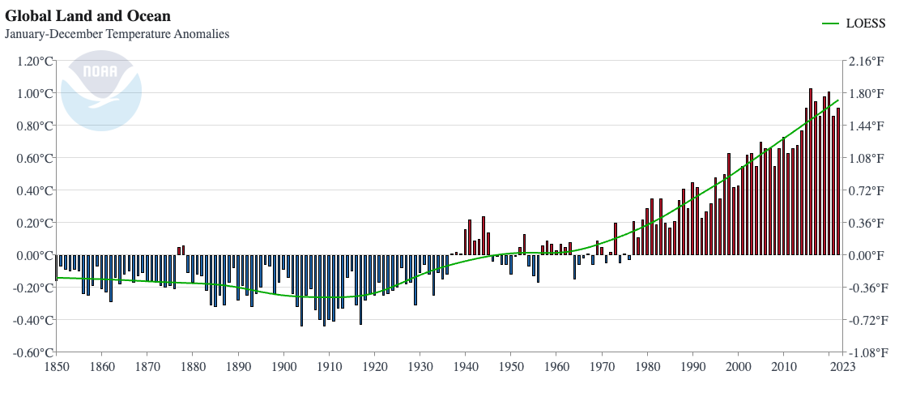
What is Global Warming Level (GWL)?
GWL is the change in globally averaged temperature temperature relative to a baseline period
  Global Mean Surface Temperature (GMST) – near-surface (2m) air temperature over land and ice, and sea-surface temperature over oceans (typically)
  Global Mean Surface Air Temperature (GMSAT or GSAT)
We are currently at ~ 1.1 – 1.2° C above
the 1850-1900 baseline
Source: NOAA Climate at at Glance
1850-1900 climate baseline period typical, but others used (“pre-industrial”, 1901-2000)
Baseline shifts are easy--just add or subtract
Moving average – typically 20 years -- to lessen fluctuations due El Niño, random weather effects, etc.
IPCC AR6: GWL is an “integrating dimension” – underlying model simulations and scenarios are the foundation, but GWL is used to filter/align according to the GWL

Slide 4
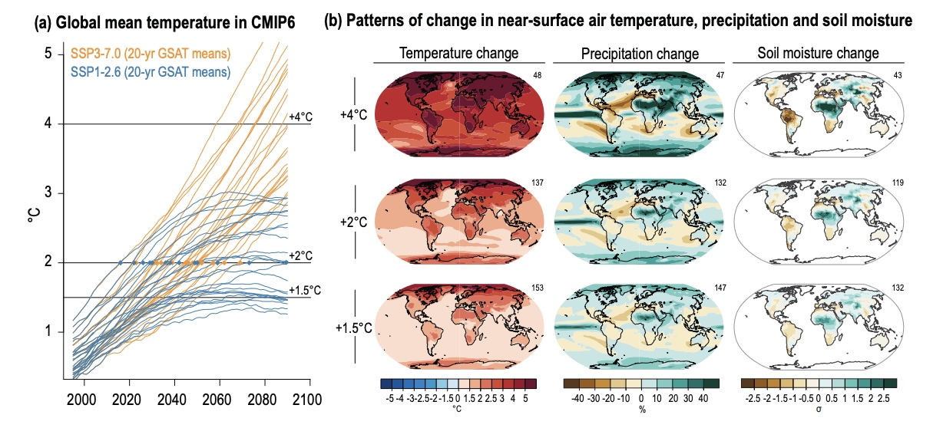
What does GWL mean for regional/local changes?
Many local and regional climate variables scale with change in GSAT.
For fast-response variables, the changes are mostly independent of WHEN…
For SLR and other variables where the rate of change scales with GWL, so a time frame is needed as well.

Slide 5
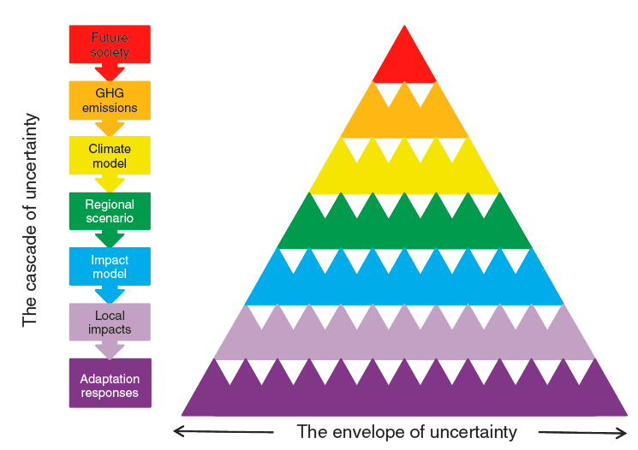
GWL vs. Emissions Scenario Approach
Global
Regional/Local
The GWL approach does not eliminate uncertainty compared to using Emissions Scenarios, but it refactors it
4C
3C
Prob(GWL) * Prob(ΔX_{local})|GWL)
2C
The “Cascade of Uncertainty”
Adapted from Wilby and Dessai (2010)

Slide 6
Potential Advantages
More tractable treatment of uncertainty
Physical quantity that will outlast specific scenario names and definitions (SRES -> RCP -> SSP -> ??? -> ??? )
Global policy aimed at GWLs -- 2°C, 1.5°C --“we are steering the ship”
Deep uncertainty in time – planning for beyond 2100
Alignment of climate hazards from disparate sources
Easier to communicate?
“hot” models in CMIP6
ASCE7-28 Chapter 36 (“Future Conditions”) is currently considering using GWL approach where possible “3 °C by 2100 ” (or a variant of this)
Caveats
Relatively new approach for climate adaptation -- not everything may scale well.
Nonlinear effects/rapid transitions (snow loads?)
Cases where specific time evolution matters
Locations where strong regional anthropogenic forcing is important (aerosols, black carbon)

Slide 7
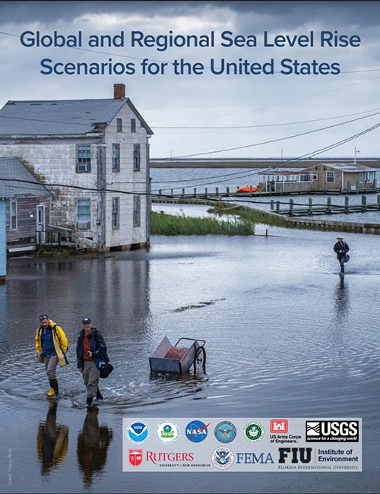
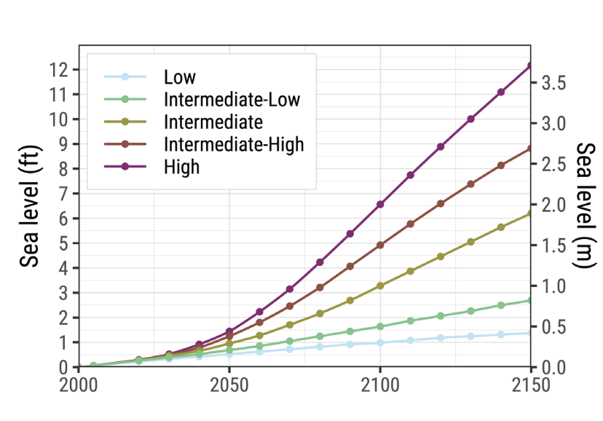
Why am I talking about this in a session on Sea Level Rise?
One of the first major climate adaptation documents to adopt GWL as an “integrating dimension” for its long-term (post-2050) projections
As in 2017 report, local and regional SLR projections are keyed off of global mean SLR projections.
2022 Report uses GWL in 2081-2100 period to filter the global SLR projections that are the basis for the regional SLR projections.
“updated temporal trajectories and exceedance probabilities now based on global warming levels rather than emissions scenarios.”

Slide 8
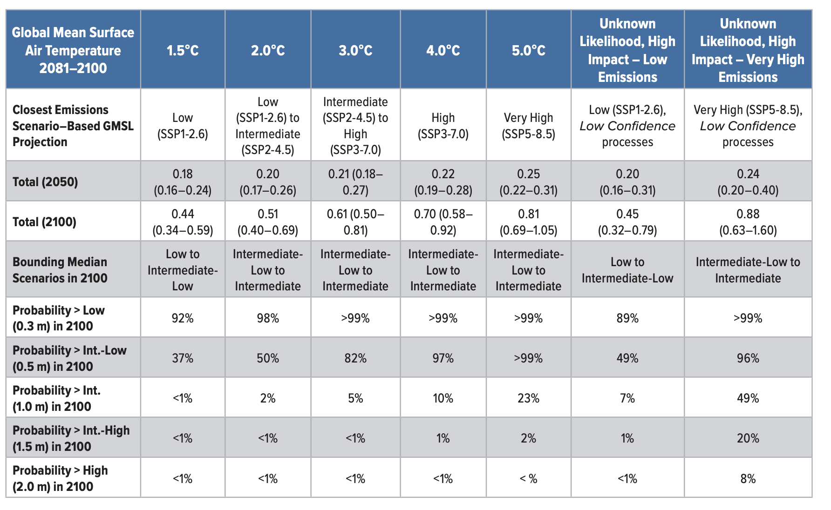
SLR Report Table 2.4
Let’s take some time to look at this… and see how this illustrates the previous points.
Notes:
Table 2.4: IPCC warming level–based global mean sea level projections. Global mean surface air temperature anomalies are projected for years 2081–2100 relative to the 1850–1900 climatology. Sea level anomalies are relative to a 2005 baseline (adapted from Fox-Kemper et al., 2021). The probabilities are imprecise probabilities, representing a consensus among all projection methods applied. For imprecise probabilities >50%, all methods agree that the probability of the outcome stated is at least that value; for imprecise probabilities

Slide 9
Aligning Climate Hazards
This will allow alignment of multiple hazards in a manner consistent with climate science
Precipitation extremes
Wind extremes - in particular, tropical storm/hurricane
Temperature extremes
Riverine flooding
Urban flooding
Are we there yet?
Not really – most climate datasets (particularly downscaled datasets) still use scenario/time as integrating dimension
NOAA Atlas 14->15 transition is being requested to offer GWL as integrating dimension
Vetting during ASCE7-28 process

Slide 10
Questions
What benefits do YOU see in using GWL approach to describe future “design climates” compared to the traditional Emissions Scenario (RCP/SSP) approach?
What drawbacks?
What impediments to using this approach?
If this approach were adopted in ASCE standards– what considerations would you like to see?

Slide 11
Further Reading
2022 Interagency Sea Level Rise Technical Report
Sweet, W.V., B.D. Hamlington, R.E. Kopp, C.P. Weaver, P.L. Barnard, and co-Authors, 2022: Global and Regional Sea Level Rise Scenarios for the United States: Updated Mean Projections and Extreme Water Level Probabilities Along U.S. Coastlines. NOAA Technical Report NOS 01. National Oceanic and Atmospheric Administration, National Ocean Service, Silver Spring, MD, 111 pp.
IPCC AR6 Technical Summary – section
Arias, P.A., N. Bellouin, E. Coppola, R.G. Jones, G. Krinner, and co-Authors, 2021: Technical Summary. In Climate Change 2021: The Physical Science Basis. Contribution of Working Group I to the Sixth Assessment Report of the Intergovernmental Panel on Climate Change [Masson-Delmotte, V., P. Zhai, A. Pirani, S.L. Connors, and co-Editors (eds.)]. Cambridge University Press, Cambridge, United Kingdom and New York, NY, USA, pp. 33−144. doi: 10.1017/9781009157896.002.
ASCE-NOAA Workshop Report:
More on Carbon Budget Approach:
Matthews, H. D. et al. Opportunities and challenges in using carbon budgets as a guide for climate policy. Nat. Geosci. 13, 769–779 (2020).

Slide 12
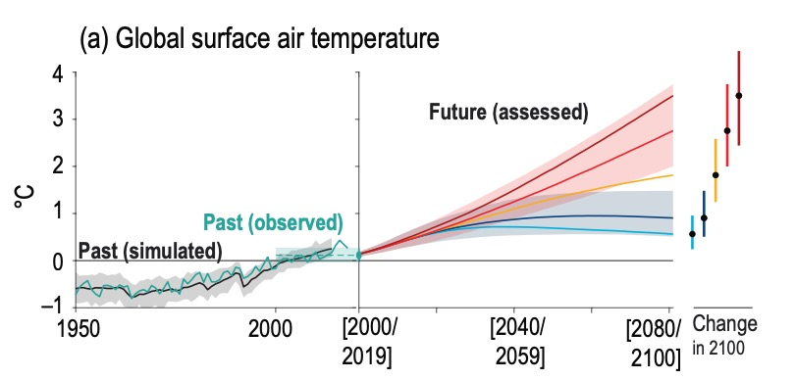
What is Global Warming Level?
What is GWL?
Global average (near-)surface air temperature has increased by about 1.1-1.2 ℃ since the 1850-1900 baseline and is projected to increase further by the end of the century. For each emissions scenario there is an overlapping range of global warming levels.
Adapted from IPCC AR6 Technical Summary Figure TS.8 Changes shown relative to 1995-2014 baseline

